Slide 1
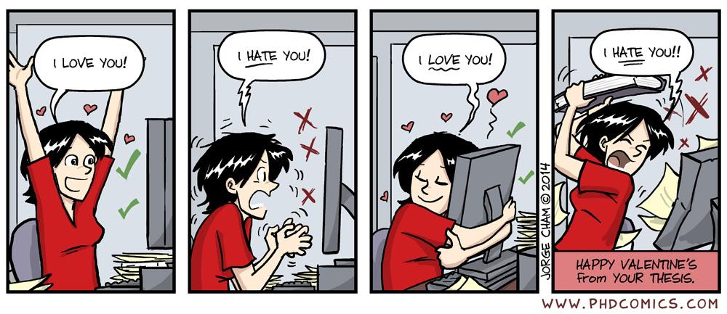
User interface design

Slide 2
UI Design: Week 7, Wed
Dr. Jillian Aurisano
Plan for today:
Announcements/Course logistics
People- part 2
Activity- project activity
Next week- I’m not traveling
Efficiency, Errors
Project work time
Notes:
So welcome to engineering visual interfaces for data science. I'm Dr Aurisano.
Thanks for finding the class on Zoom. Hopefully we will be in person again soon.
If anyone out there is comfortable turning on their cameras, that is lovely- then I feel like I am talking to students, rather than to myself.
Here’s our plan for today:
First I’m going to introduce myself, so you know a bit about me
Then we are going to get to know each other, in Zoom breakout rooms. This will give us a chance to make sure that Zoom breakout rooms work, and we all know how to access them.
Then, I am going to walk through the structure, and plan for the course. I want to make sure everyone knows how the course will work, and what to expect, and also a bit about why the course is designed this way.
Then I am going to introduce the class, and what the class is about. Since this is a new class, and one of just a few classes in human centered computing here at UC, I wanted to give an overview of the topic.
Then I have an introductory activity, which we will do in breakout rooms, and which I think will help motivate the discussion on Wednesday, and getting into the meat of the class.

Slide 3
Project 2 questions?

Slide 4
Continue our discussion of people
We’ve talked about perception and attention
Let’s continue with processes that sit between low-level, unconscious perception and cognition
A bit more about reading
Influence
More on people to come…

Slide 5
How we read

Slide 6
Reading is unnatural
We are wired with an innate ability to develop speech and understand spoken language
We are not wired to read
Reading and writing comes from practice and instruction
Reading requires some degree of conscious attention and effort
Reading requires more cognitive effort than other processes
We want to make this as easy as possible

Slide 7
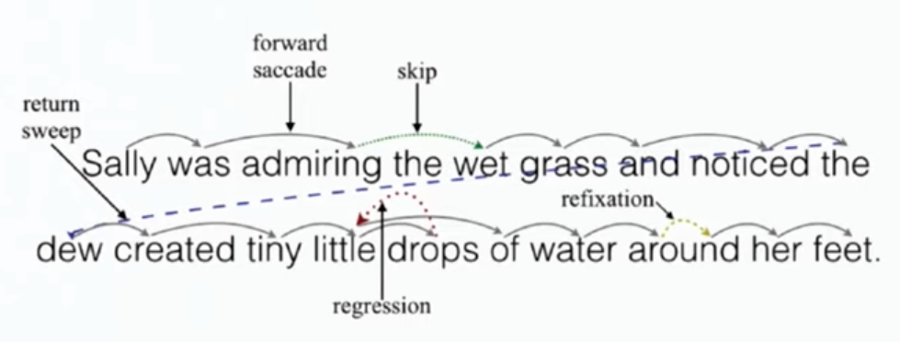
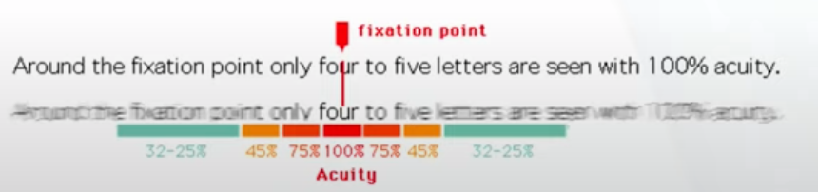
Process of seeing words
When we read, our eyes alternate between brief periods of fixation (250ms), and jumping between words (saccades)
During a saccade we can’t see words
Most saccades jump forward (over one or several words)
10-15% of the time saccades jump back, to reread or refocus on letters/words

Slide 8
Identifying letters and words in different fonts
Different fonts can be used to shape the association or mood within a piece of text
Classical, modern, serious, playful
When choosing a font it is important to select one that doesn’t meaningfully interfere with the brain’s ability to recognize and group symbols, and thereby identify words etc
Aside- serif and sans-serif fonts are not much different in terms of interpretability

Slide 9
Study
Song and Schwarz (2008)
Two groups of participants were given a series of instructions which differed only in the font that was used
One font was easy to read, the other was long
Participants were asked to estimate how long it would take to complete the instructions
The easy font group estimated 8 min
The hard font group estimated 15 min

Slide 10
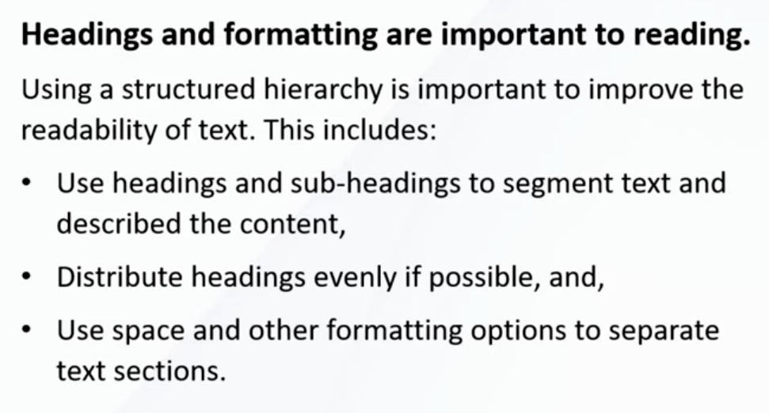
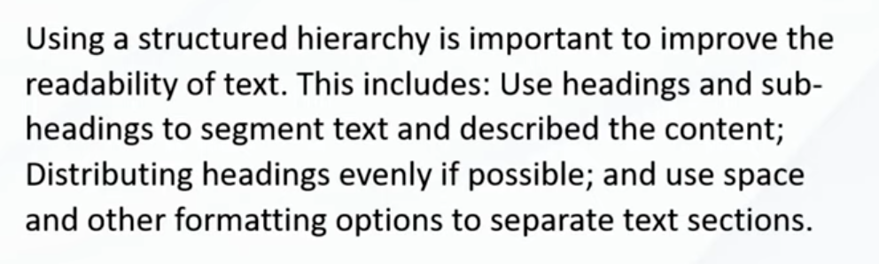
We discussed the value of using hierarchy to help people read

Slide 11
People read faster with long line lengths But prefer shorter line lengths
Longer line lengths (100 characters/line) are faster to read
Do not require the eye to jump back over the page to the next line as often
But, people prefer smaller line length
Takeaway- is reading speed an important characteristic? If not, favor shorter lines

Slide 12
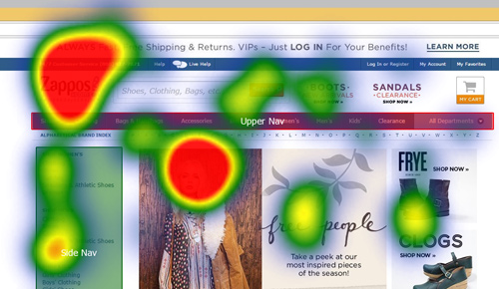
We scan, we don’t read
We scan
We look for things that catch our eye
We don’t want to waste time and effort

Slide 13
Take-aways
Make reading as effortless as possible
Use an easily readable font
Use a clear and consistent layout of text
Use plain language
Omit needless words
Do you really need a long welcome with informational overviews
Minimize instructions that need to be read

Slide 14
Influence

Slide 15
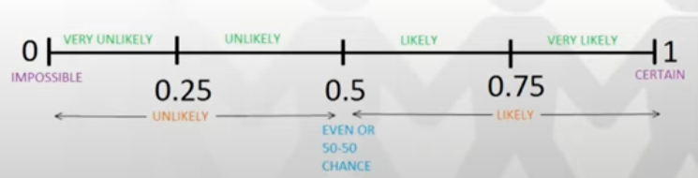
Write down an answer
Influence: exert some effect on people so that they are more likely to favor one outcome over another
What do you think?
Q1 : How easily are people, in general, influenced?
How easy is it to get people to favor one outcome over another?
Q2: How easily are you influenced?
0: impossible to influence <people, you>
…
1: certain: <people, you> are influenced all the time

Slide 16
Let’s look at some examples
1974 study
2 groups of high school students
Gave them 5 seconds to answer a complex mathematical question
Can’t solve it, but need to estimate
We are going to try this in class!
Everyone on one half of the room close your eyes.

Slide 17
Let’s look at some examples
1974 study
2 groups of high school students
Gave them 5 seconds to answer a complex mathematical question
Can’t solve it, but need to estimate
We are going to try this in class!
Everyone on one half of the room close your eyes.
Group 1: 1x2x3x4x5x6x7x8
Quick estimate

Slide 18
One half of the room
Group 1: 1x2x3x4x5x6x7x8
Quick estimate!
Close your eyes

Slide 19
Other half of the room
Group 2: 8x7x6x5x4x3x2x1
Quick estimate

Slide 20
Answers
Group 1:
- 30000, 99, 40k, 250, 6000,
Group 2:
- 12500, 256, 40k, 41k,
Did we replicate the study?

Slide 21
Answers
Did we replicate the study?
1x2x3x4x5x6x7x8
8x7x6x5x4x3x2x1
Same answer: 40,320
Median guess of the first group: 512
Median guess of the second group: 2,250
Why?

Slide 22
Anchoring bias
Cognitive bias
An initial piece of information *the anchor* impacts your subsequent thought process and decision making
Once set, future estimates, decisions, negotiations are conducted relative to the anchor value
Aspects that align with the anchor tend to further strengthen the anchoring effect
Aspects that are dissonate or less related tend to be more readily ignored or devalued

Slide 23
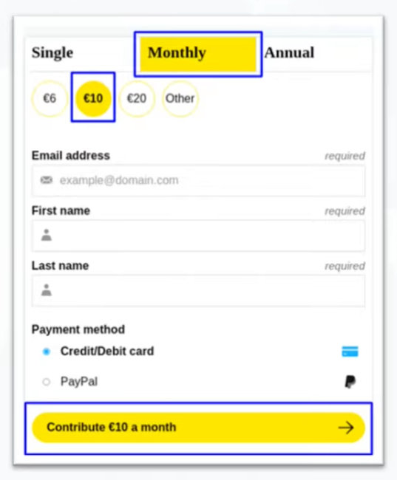

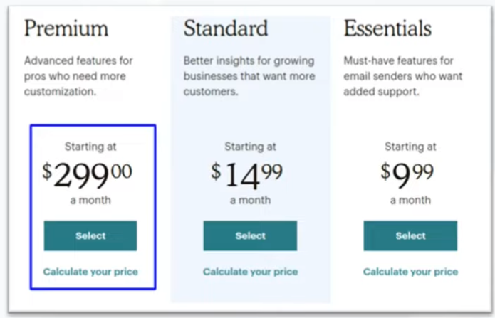
Anchoring is used all the time
Especially in marketing
Display original and discounted prices together
Providing a suggested value for a donation
Listing the most expensive option first

Slide 24
Surprising anchors
We are also influenced by anchors that seem irrelevant. Things that we would not expect to influence our decision
1998 study (Waksink) conducted an experiment selling soup
Modest reduction in price was set alongside three different restrictions on the number of cans that can be purchased
(max 4 cans) (max 12 cans) (unlimited cans)
What do you think happened? Which resulted in the most purchases?

Slide 25
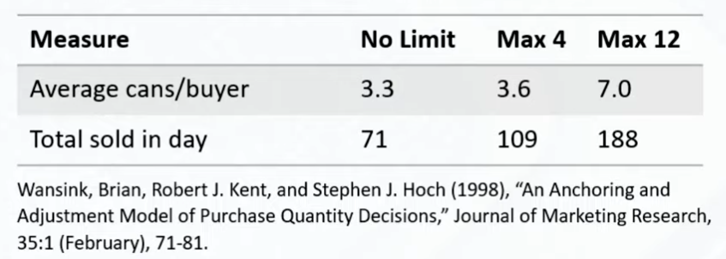
Results
The larger the anchor value for the purchase limit, the more people bought
We might have expected that having a low limit suggests high demand and high value
Oh we can only buy 4? People must really want this soup.
But the opposite was true
This anchor did have an impact

Slide 26
Another example
Everyone think to yourself- what is the last 2 digits of your social security number. You can write it down if you want to.

Slide 27
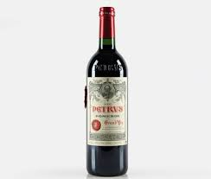
Another example
How much would you pay for this bottle of wine. Write down a number.

Slide 28
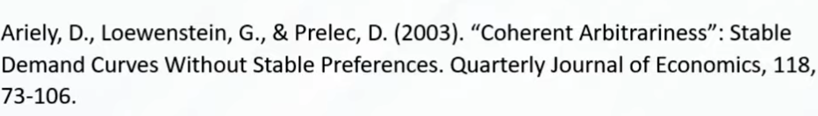
Another example
This is similar to a study done in 2003 (Ariely)
Participants asked to recall the last 2 digits of their social security number
After this, they were shown a bottle of wine and asked how much they would be willing to pay for it
The last 2 digits of your social security number strongly influenced how much people were willing to pay
Lowest 20% of social security numbers, offered $8.64
Top 20% of social security numbers, offered $27.91

Slide 29
Another example
1996 study (John Bargh)
Given a task to unscramble sets of words to make short sentences
She Belfast lives in → She lives in Belfast
Some people were given sets of words that contained words associated with being old (retired, elderly…)
Some people were given sets of words that contained words associated with being young (youth, energetic….)
After unscrambling the words they were told the experiment was done, and sent on their way.
But they measured how fast participants from each group walked down the hallway after the study
Those exposed to ‘old’ words walked much more slowly than those exposed to ‘young’ words.
They were asked if they felt influenced by the words in their sentences, and they say no
But of course, they were influenced

Slide 30
Impact of initial pieces of information
Related or unrelated pieces of information
You may think- well this doesn’t apply to you
Third person effect
Why don’t we think we can be influenced?

Slide 31
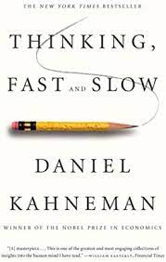
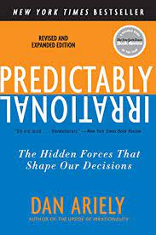
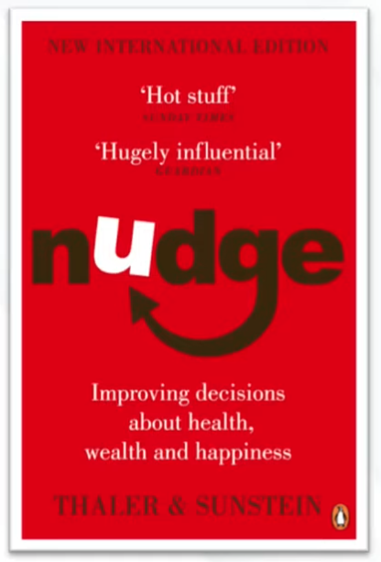
Lots of things impact our thinking
Books on this:

Slide 32
Cognitive biases
Anchoring effect is one cognitive bias, There are lots of others
Cognitive biases exist to help us think fast
We often aren’t making slow, rational decisions based on a complete understanding of the facts
We use shortcuts to help us make fast decisions
Heuristics- are one way, rules informed by experience which help us make decisions
Some of these can lead to errors in thinking- cognitive biases

Slide 33
Cognitive biases- for good, not for profit
Lots of the examples I found were in contexts where you wanted to get someone to spend money
Let’s just keep in mind, this effect could also be used for other goals
Getting people to….
Reach their goals
Care for others
Take care of themselves
Can we come up with an example of using anchoring effect in a UI to help someone:
Get more exercise
Find more time to study

Slide 34
Another cognitive bias: sunk cost fallacy
If we already invested resources in something, we’re going to keep investing more
We don’t want our efforts to go to waste
Examples:
Finishing a bad movie
Continuing to poor time and money into a project we don’t think is working out
Related to loss aversion
Losing $100 hurts more than gaining $100 satisfies
How does this relate to UI design

Slide 35
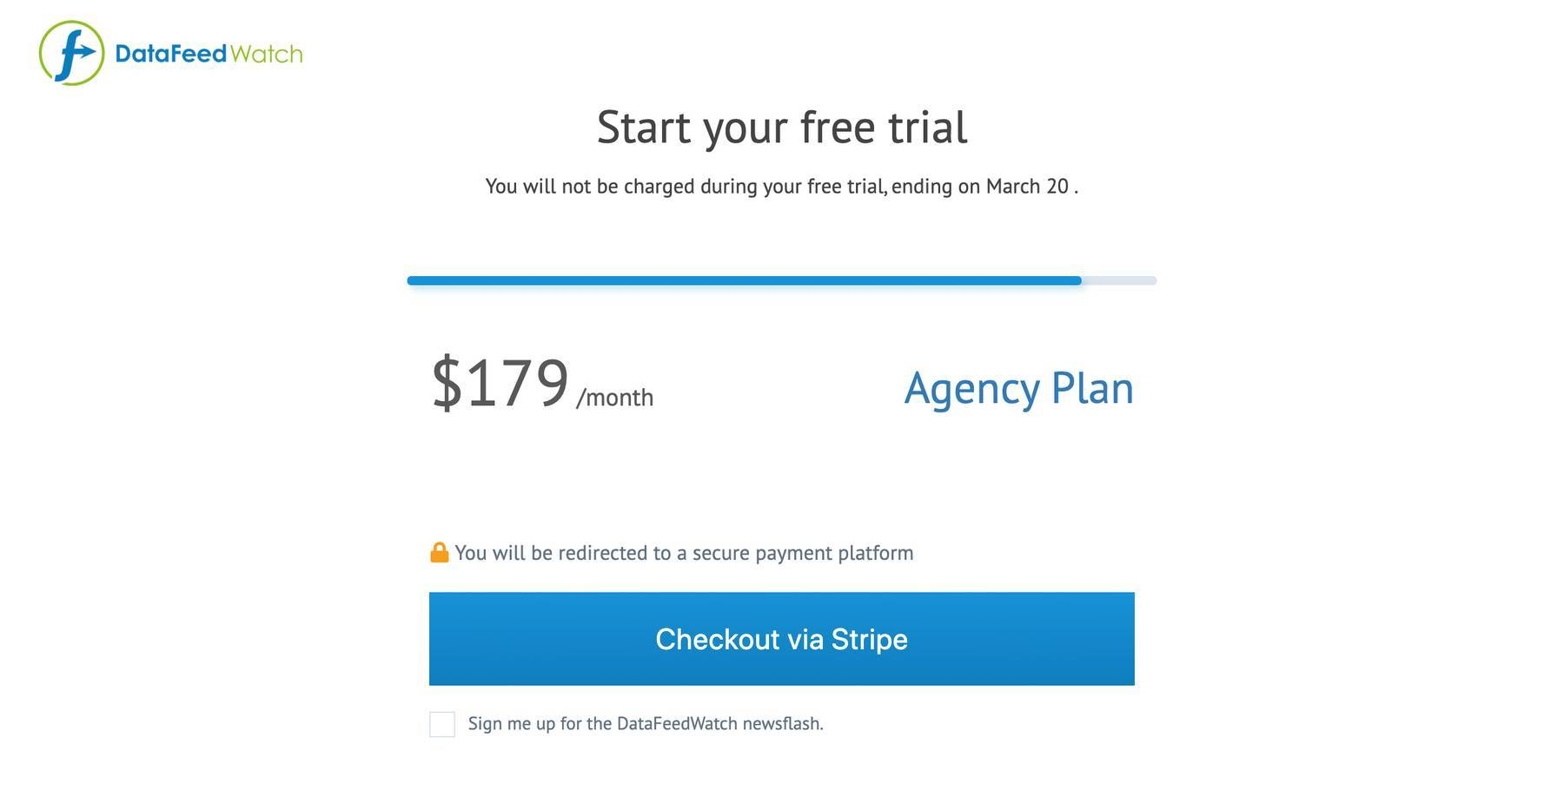
Sunk cost fallacy and UI design
The sunk cost bias may be part of the user flow
Suppose you are signing up for a service or making a purchase
Progress bar: encourage users to complete their actions
Suppose you want them to finish making the purchase
Show them this is the last step of the process
Once again- let’s think about how we could use this for helping someone….

Slide 36
Sunk rewards
Loyalty programs, sunk rewards encourage the user to stick to your product
“I don’t want to lose these potential rewards”

Slide 37
Note to self- sunk cost fallacy applies to our work too…
We may tend to stick to a less than great design because of the sunk cost fallacy
I’ve already put so much into this feature!
I can’t give up on it now!

Slide 38
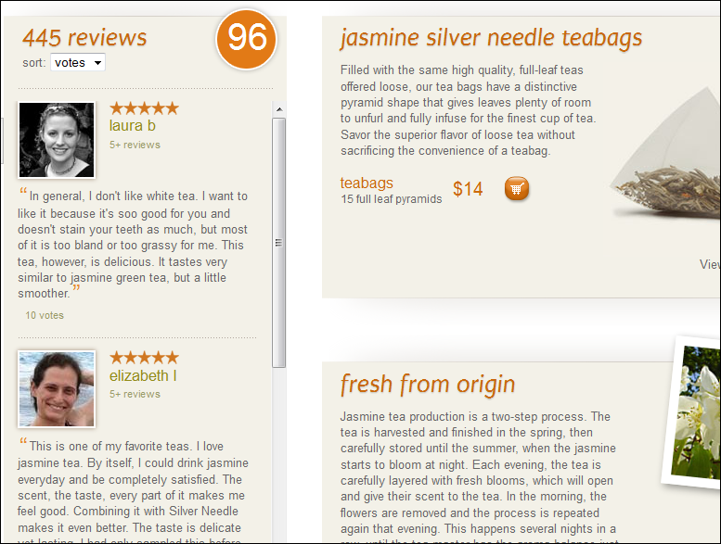
Social proof bias
We are guided by the behavior of others
This bias serves an important pro-social function
Example: Reviews
We think- other people want it and like it, it must be good

Slide 39
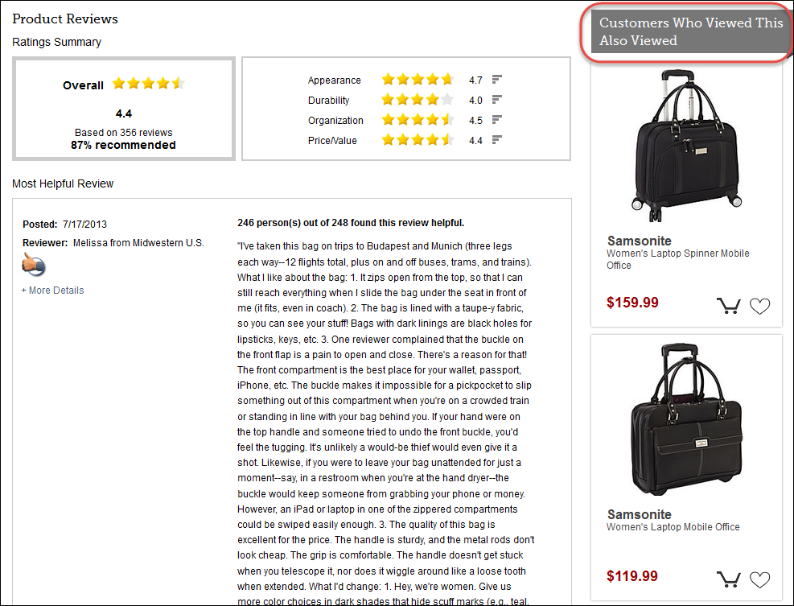
Social proof bias
Other people who viewed this, also viewed

Slide 40
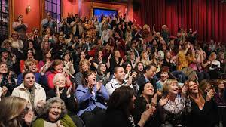
Social proof bias
Laugh track
We all think we hate it
But people laugh more and rate the material as more funny with a laugh track

Slide 41
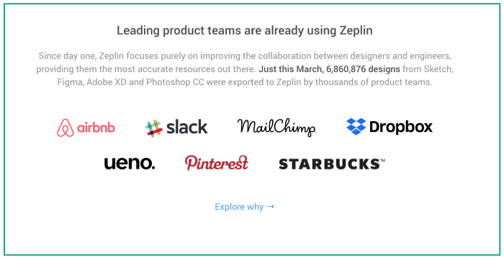
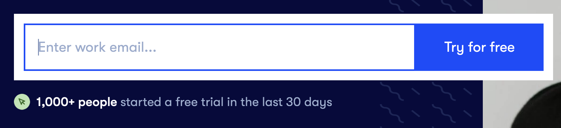
Bandwagon Effect
Herd behavior
Tendency to do or believe things many other people do or believe

Slide 42
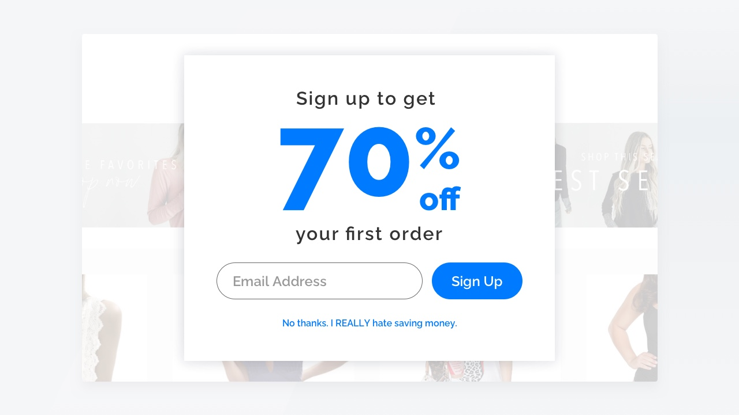
Confirm shaming
Making people feel like they aren’t in the ‘cool group’. They are missing out, not doing what others are doing….

Slide 43
Confirmation bias
When presented with new information, we tend to only selectively pay attention to information that confirms what we already think
You see this a lot in the news: If you present people with news articles that fit with their current entrenched beliefs, they are more likely to remember it
Everyone suffers from this…

Slide 44
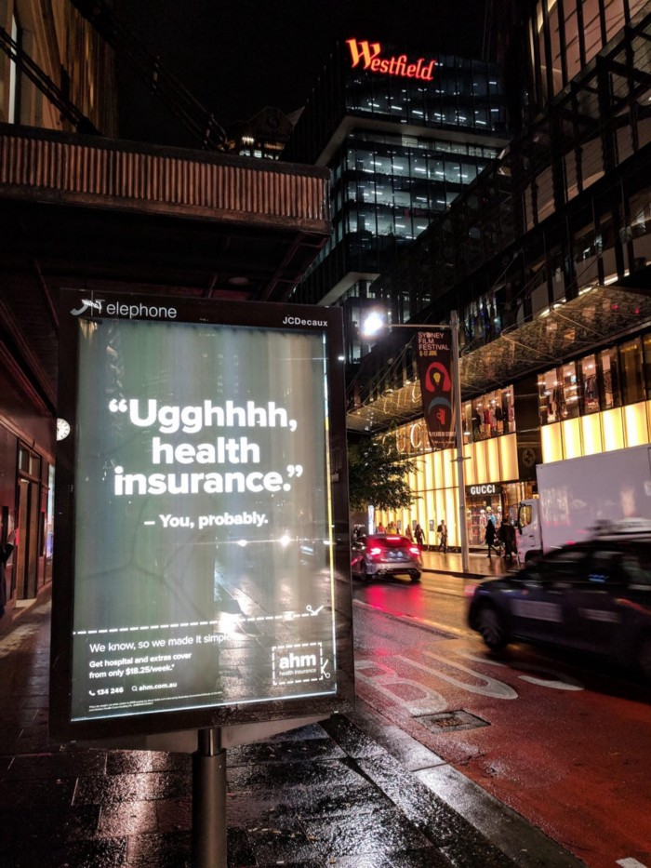
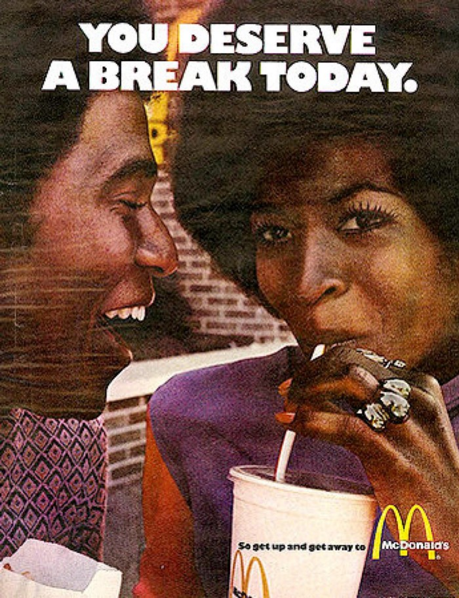
Confirmation bias and UI
Yes, I do!
Yes, I do hate health insurance

Slide 45
BIG issue in the design of personalized content
Do you want to inform people?
Are you just feeding people things they already believe?
We can discuss this more later…

Slide 46
Continue our discussion of people
Remembering
Thinking
Motivation
Decision making

Slide 47
How we remember

Slide 48
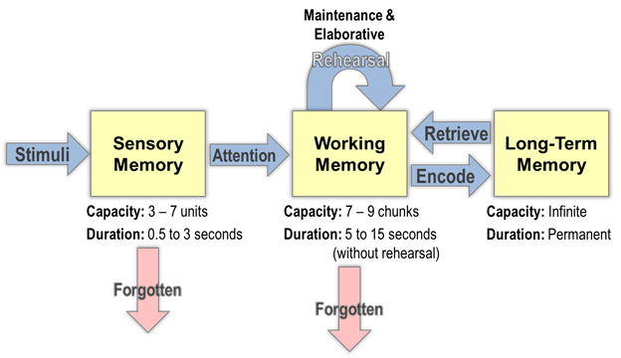
How does memory work?

Slide 49
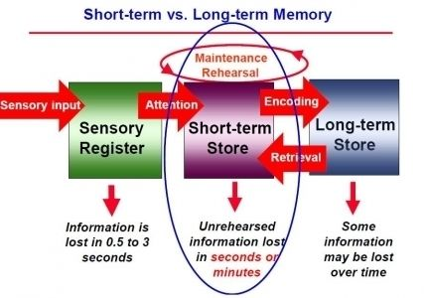
Working (short term) memory
When you focus your attention on certain pieces of information, you hold the information in your working memory
Working memory
Operates over a few seconds
Has a limited capacity- often measured by asking people to recall lists of numbers or words
When your attention gets directed elsewhere, whatever is held in working memory is unlikely to be retained.
You will forget that number or that random word, unless you continue to direct effort toward them

Slide 50
Goal: Minimize how much we require users to hold things in their working memory
Example- remembering settings or values between pages
If users must remember information, don’t ask them to do anything else until the task has been completed
Any tasks that are likely to be stressful to the user should not require the user to rely upon their working memory
Stress impairs the effectiveness of working memory
Transferring money
Dealing with a medical issue…

Slide 51
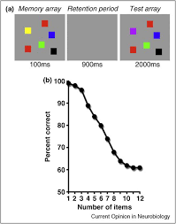
Working memory capacity
Working memory recall is limited and imperfect
The more information we try to hold, the worse our recall is
As a good rule of thumb, we can’t hold more than 4 things in working memory
We often rely upon aids (notes, lists, etc) to overcome the limitations of our working memory

Slide 52
Seeing beats memory
Displayed information that is visually available will always be easier for people to access than information they have to recall in their memory
Example:
Think about how it feels to switch between tabs in your browser
vs working with an external monitor where you can display more than one window next to each other
There is always a trade-off between the amount of space you have to work with as a designer, and this need to ensure people can ‘see’ the information they need

Slide 53
What can help us remember
Concrete words can be remembered more easily (cat, tree) than abstract words (freedom, justice)
Easier to remember visual items than words
So- if you want someone to remember something, it might be better to use visuals and concrete terms where possible

Slide 54
How we think

Slide 55
Mental models
Mental models encapsulate our thoughts around how something will behave, react or work
Our mental models shape our actions and behavior in terms of how we approach situations and interact with others
We refer to mental models when we interact with new interfaces
We create these models quickly based on prior experiences and assumptions
These can change
And they differ between individuals

Slide 56
We design using conceptual (Represented) models
We try to design using a conceptual model of how the user will interact
Conceptual models may differ from a particular user’s mental model
If there is a mismatch between the conceptual model the designer is using, and the mental model the user has, this will produce usability problems
We want to try to understand what kinds of mental models users are likely to use
To do this- we may want to model their goals, get into their personas, etc.
Novel products may need to have more training to shape and influence the development of a user’s mental model

Slide 57
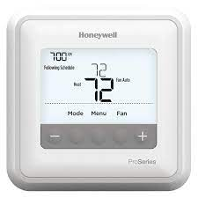
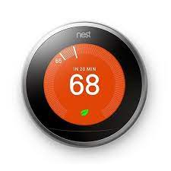
Example – from earlier
Mental model of a thermostat and heating system
When I turn this nob, does more heat come out?
OR, when I turn this nob, does the heat come on at a higher temperature, so it won’t let it go below a higher temperature

Slide 58
Cognitive load
As users interact with software, they do a range of activities
Cognitive activities- thinking about something, remembering something
Visual activities- looking to find a particular piece of information
Motor activities- moving a pointing, pushing a button
Each type of activity requires mental effort, which varies depending on the tasks
Cognitive tasks are more demanding than visual tasks followed by motor tasks
We want to minimize the overall cognitive load on the user
Example- requiring more mouse clicks (motor tasks) in order to minimize their thought and memory, might be a good tradeoff

Slide 59
Progressive disclosure
Progressive disclosure involves only providing information when it is needed or relevant
Avoid the risks of information overload
But, from a design point of view, the designer must understand and predict what the user will need at each particular stage

Slide 60
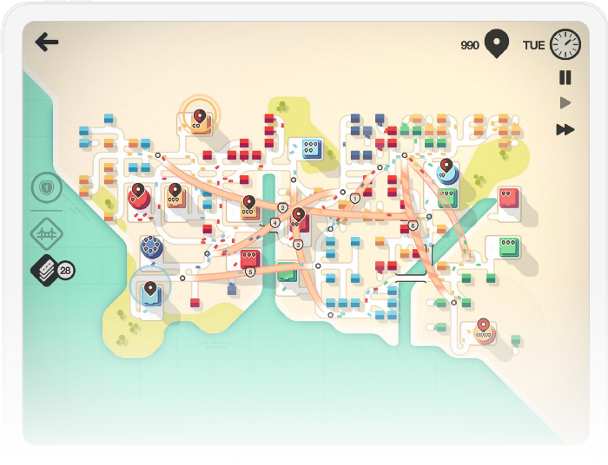
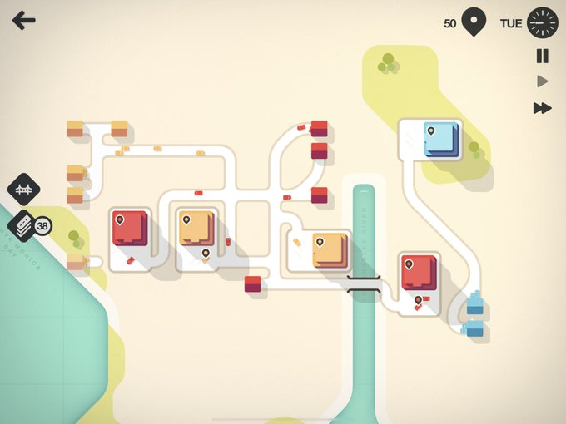
Progressive disclosure example
Game: Mini-motorways

Slide 61
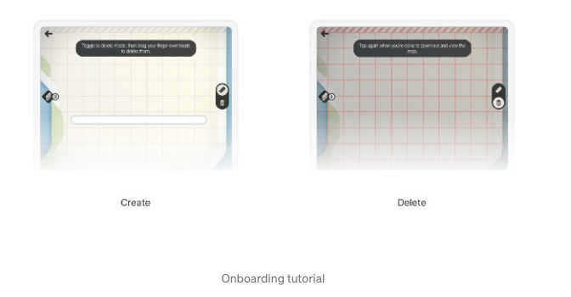
Progressive disclosure
Don’t start with creating the whole map, or all the functionalities and all the game play mechanisms
But, start with a few core steps
Create roads
Delete roads

Slide 62
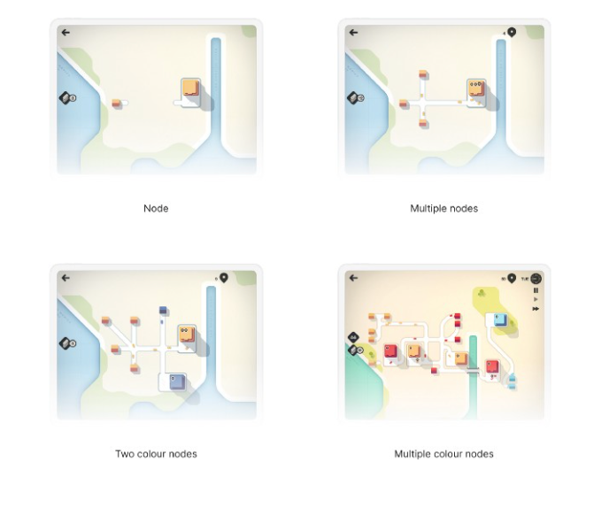
Progressive disclosure
Then teach the next step
And the next
Build a little area
Then they have the building blocks to play

Slide 63
Our minds wander a lot
Mind wandering is like day-dreaming
It arises when we stop doing a task and start thinking about something unrelated to that task
We ALL do this – studies have suggested we can only focus on something deeply for 10 minutes or so, before our minds wander
What should we do- we need to make sure we include elements that help the users orient themselves quickly
They open an application, get distracted and go on their phones, and then come back
Can they reorient?
More on attention later…

Slide 64
How we decide

Slide 65
Choice and control
We like to feel that we are in control
We think choice equates control
We favor having more options, even if this makes it more difficult to make an optimal (or satisfactory) choice
What presenting to the user how something will be done, good to offer some choice of approaches
Avoid taking choices away from users, even if there is an improved way of accomplishing a task
Can present a default, but don’t remove choices

Slide 66
How much choice?
We generally think that more choice is desirable compared to less choice
But too many choices can overwhelm our ability to make a decision
Iyengar and Lepper (2000) study
If asked to choose between 6 different jams or 24 different jams
Less choice-> greater sales
Limiting choices can actually make people happier
Progressive disclosure is one approach to limiting choices
Initial selection from a broad category, then a more narrow category

Slide 67
Uncertainty-> follow advice of others
The opinion of others can influence our decisions, especially when uncertain
Approaches to harness this: recommended options, reviews, testimonials

Slide 68
We settle
Most of the time (not always) we “satisfice” (satisfaction + sufficient)
When we are satisficing, we get a feel for the number of options, and then we feel content ‘ok there is a reasonable amount of choice’
Then we just go for something that is satisfactory and sufficient
Evolutionary perspective- making optional decisions can take time and require lots of cognition, but good enough+fast decisions require less time and effort

Slide 69
What this means from design perspective
Users will scan the screen and pick options that look ok
They will probably not read instructions
We want to make sure we have an idea for how users scan the screen

Slide 70
How are we motivated

Slide 71
Why motivation matters
As designers of interfaces we sometimes want to motivate specific behaviors or actions in our users
Also, lots of interests in tools that motivate people to reach their goals
Let’s think of some interfaces we have interacted with that aim to motivate us in different direction….

Slide 72
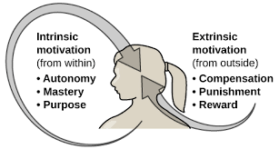
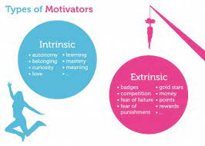
How are we motivated?
Intrinsic rewards- internal to the individual
I am motivated because I want to master this
Extrinsic rewards- external rewards you get for doing the task
Points, badges
Which is better?
Intrinsic motivation is a stronger long-term motivator
Better to care about mastery, rather than ‘points’
Think about how you learn when you want to master a skill vs when you just want a grade
Ideally, if your goal is to motivate, we want to encourage intrinsic rewards (mastery, new capabilities, curiosity)
More solid foundation for encouraging behavior

Slide 73
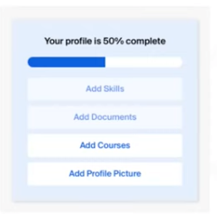
Progress, mastery and control are good motivators
Highlighting small steps that will result in increased progress or mastery
If it feels ‘big’, it is harder to motivate than if it feels small

Slide 74
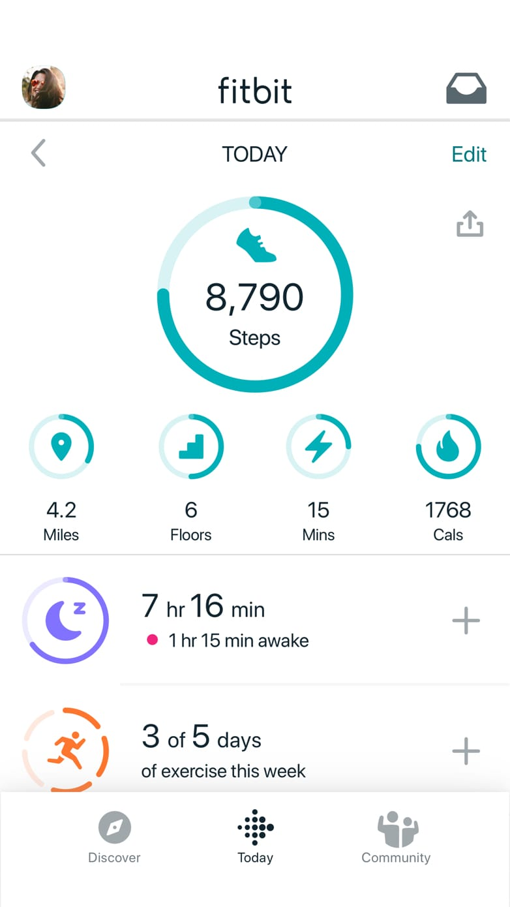
Progress, mastery and control are good motivators
If you want to encourage greater participation, it helps to:
enable and encourage users to set and track their own goals
enable them to track progress

Slide 75
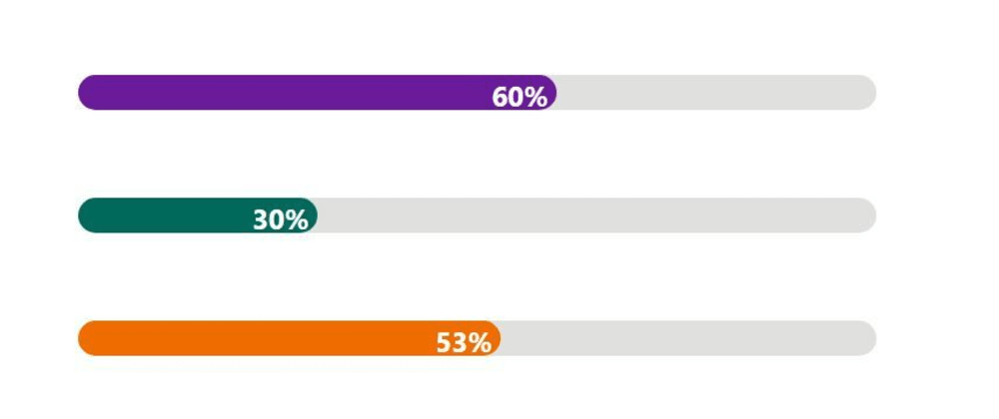
Distance to our goal
We tend to focus more on what’s left to do rather than what has already been done
Better to highlight what’s left to do rather than what has already been done
The closer we get, the more motivated we are to reach it
Visual representations of progress and closeness to a goal are often useful
Note- motivation can drop once the goal has been achieved
How to sustain motivation following this?

Slide 76
How does # of competitors impact motivation?
Garcia and Tor (2009) study.
Students brought into a private room
“Complete a short quiz as quickly as possible”
“The top 20% will get a prize”
Note- 20% is a relative number (if 10 students in the room, 2 students get a prize. 100,20 etc.)
One group was told they competed against 10 other students
A second group was told they competed against 100 other students
Which group completed the test the fastest?

Slide 77
How does # of competitors impact motivation?
Garcia and Tor (2009) study.
Students brought into a private room
“Complete a short quiz as quickly as possible”
“The top 20% will get a prize”
Note- 20% is a relative number (if 10 students in the room, 2 students get a prize. 100,20 etc.)
One group was told they competed against 10 other students
A second group was told they competed against 100 other students
Which group completed the test the fastest?
The group with fewer participants
Same chances of success… but if we feel we are up against a large number of other competitors, it lowers our motivation

Slide 78
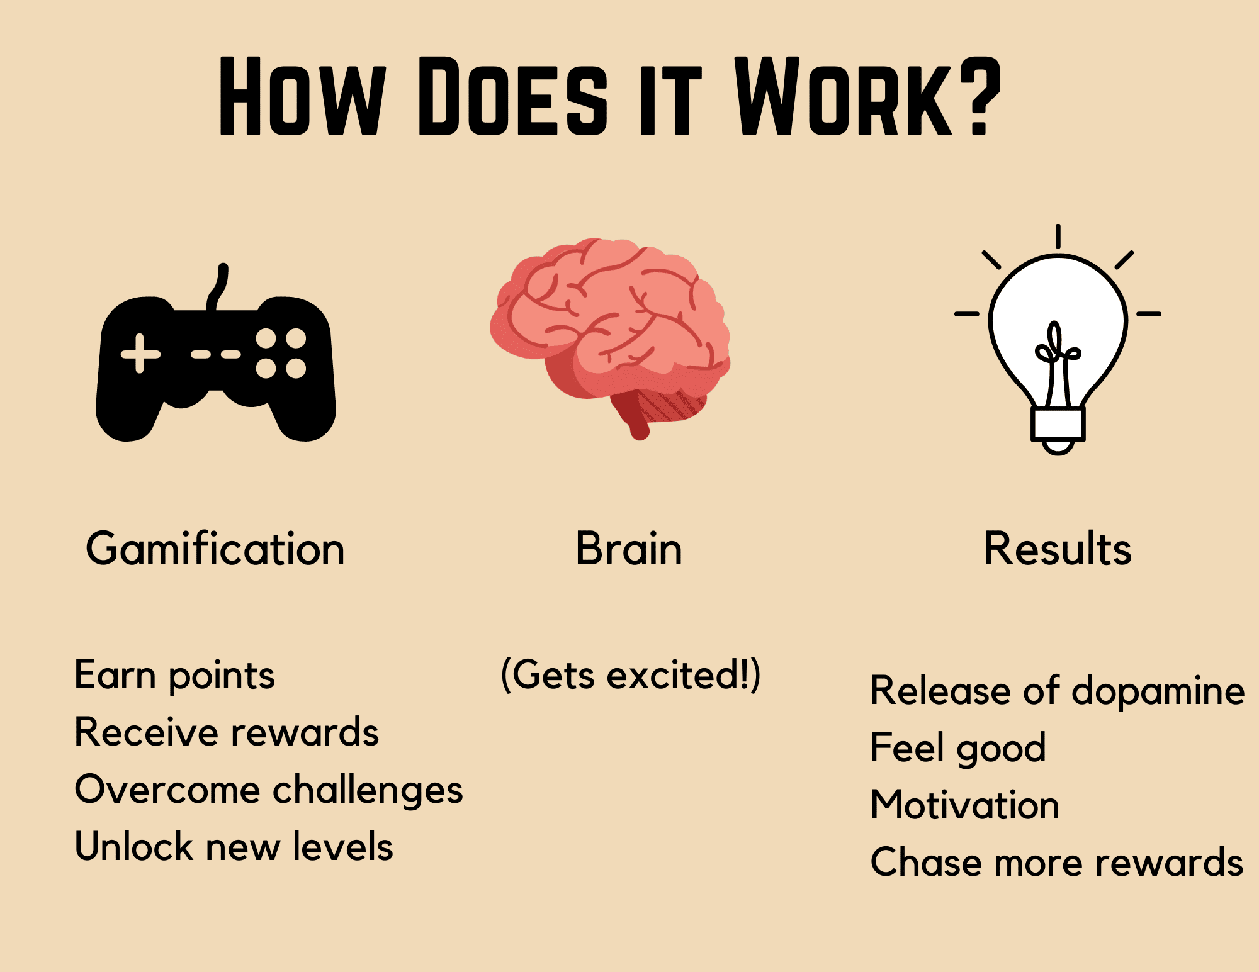
Gamification
Gamification: Take something that is not normally a game, and turn it into a game as a motivational tool

Slide 79
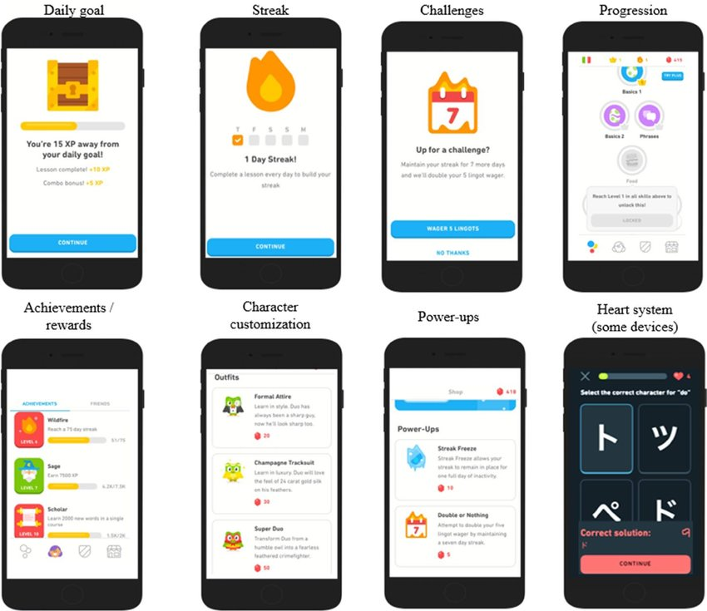
Gamification example: Duolingo

Slide 80
Activity

